Slide 1
Hippa compliant database app (doc-mobile)
CSCI 581
Mayur Potdar
Jared Dickinson

Slide 2
Motivation
 Secure virtual storage of patient information is a vital concern in our interconnected world.
 Services that offer such storage are often expensive, going as high as 200 USD a month.
 Such a service should be cheaper for those who really need/desire it.

Slide 3
What is HIPAA?
 HIPAA, the Health Insurance Portability and Accountability Act
 Changed how health care providers had to protect a patient’s health information
 Provides a data and transaction standardization that very few health care providers can sidestep if they bill third parties for services.

Slide 4
Doc-mobile’s(DOMO) purpose
Provide cheap way for people to access their heath information.
DOMO must provide appropriate data security as demanded by HIPAA.
DOMO will allow users and their healthcare professionals to quickly access certain medical information.
DOMO allows users to decide if they’re information can be shared with certain entities, following enforcing the HIPAA Privacy Rule.

Slide 5
Doc-Mobile Security
DOMO’s security focuses on two vital points at the front and back end:
Strong authentication system on the front end to determine who can reach the database.
Strong encryption system on the back end so that, if someone breaches the database, the data is in a useless state.

Slide 6
Structure of the proposed system

Slide 7
Domo setbacks
Scheduling Issues
Hardware Issues
Android Studio slowness
Intel/Emulator dilemma
Flexible HIPAA Standards
HITECH(Health Information Technology for Economic and Clinical Health)
Unlikely to provide more practical advice; something to keep in mind for a full fledged release.
iOS setbacks

Slide 8
Domo deliverables
Then
Now
Develop Android app
Develop iOS app
Develop online domain to host the database
Develop Android app
Develop online domain to host the database

Slide 9
Current Domo toolset
Will stick with Android Studio
Java for the GUI
XAMPP database
Test with Android device and PC emulator

Slide 10
Division of Labor
 Jared/Mayur – Research HIPAA standards
 Java code – Jared
 Mayur – implement online database
 Jared/Mayur – Database/App interface
 Mayur – Database Encryption
 Jared/Mayur - Testing

Slide 11
Milestones
 Step 1: System and society requirements and define the modules.
 Step 2: Develop each system module and create the database.
 Step 3: Try to connect the interface between system and database using to test the environment.
 Step 4: Develop the final project module
 Step 5: Project demonstration with the final deployment.
 Step 1: 1 week
 Step 2: 4 weeks
 Step 3: 2 weeks
 Step 4: 1 week
 Step 5: 1 week

Slide 12
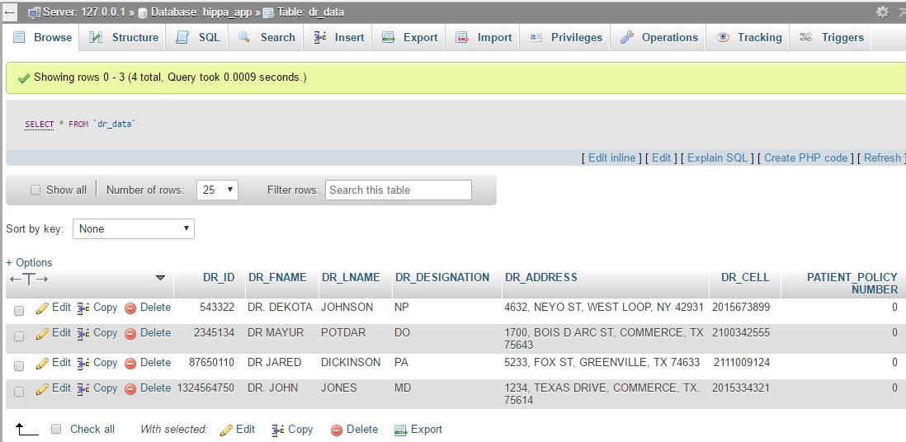
Database Doctors information

Slide 13
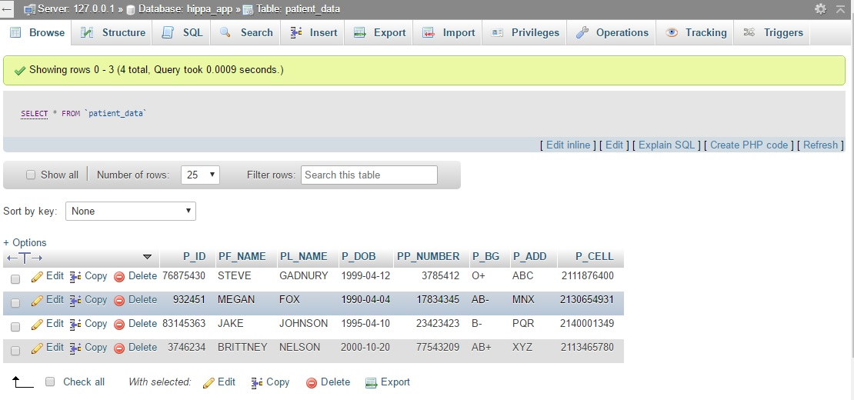
Database Patient information

Slide 14
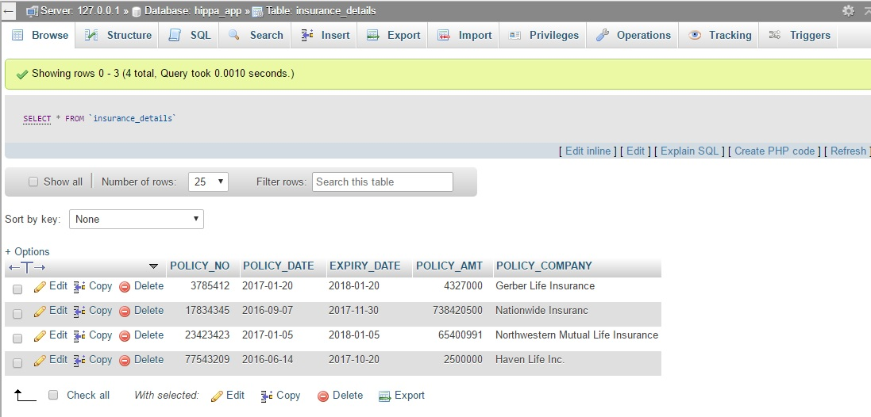
Database policy information

Slide 15
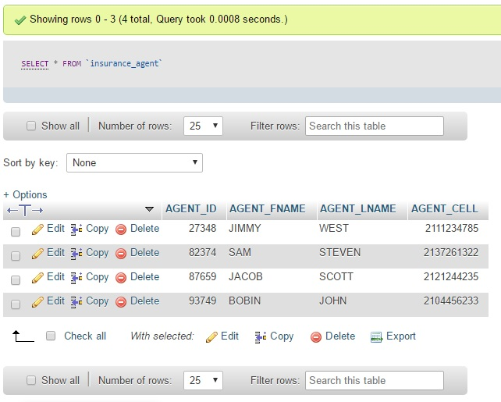
Database agent information

Slide 16
References
1] Tariq Alshugran; Julius Dichter , “Extracting and Modeling The Privacy Requirements from HIPAA for Healthcare Applications”, IEEE Long Island Systems, Applications and Technology (LISAT) Conference 2014, DOI: 10.1109
2] Denis Verdon and Gary Mcgraw “Risk Analysis in Software Design”, IEEE Journals & Magazines, 2004, pp. 79 - 84, DOI: 10.1109
3] Vivying S. Y. Cheng and, Patrick C. K. Hung “Towards an Integrated Privacy Framework for HIPAA-Compliant Web Services” Proc. E-Commerce Technology (CEC’05) 7th IEEE Int. Conf., 2005, pp. 480 - 483, DOI: 10.1109
4] Annie I. Anton, et al., “HIPAA’s Effect on Web Site Privacy Policies”, IEEE Security & Privacy - IEEE Journals & Magazines, Vol. 5, 2007, pp.45 - 52, DOI: 10.1109
5] Aaron K. Massey, et al., “Evaluating Legal Implementation Readiness Decision-Making”, IEEE TRANSACTIONS ON SOFTWARE ENGINEERING, 2014, pp. 545 - 564, DOI: 10.1109
https://www.ihs.gov/hipaa/
https://www.youtube.com/watch?v=8uFPVm_LPH8
https://www.hhs.gov/hipaa/for-individuals/index.html
https://aws.amazon.com

